Slide 1

Player Performance Prediction Using Python: Integrating Probability & Machine Learning
Arnav Verma (23BDS0123)
Parth Mital (23BCE0842)
Ved Lawand (23BDS0141)
Anshul Naphade (23BCE0061)
Faculty: Dr. Manimaran A.
Vellore Institute of Technology, Vellore

Slide 2
Abstract
This project explores the application of probability and statistical models to predict player performance in sports. Using historical player data, we analyze key performance metrics and apply machine learning techniques to forecast future outcomes. The results demonstrate the effectiveness of data-driven approaches in enhancing decision-making for coaches and team managers. This study highlights the role of probability and statistics in modern sports analytics.

Slide 3
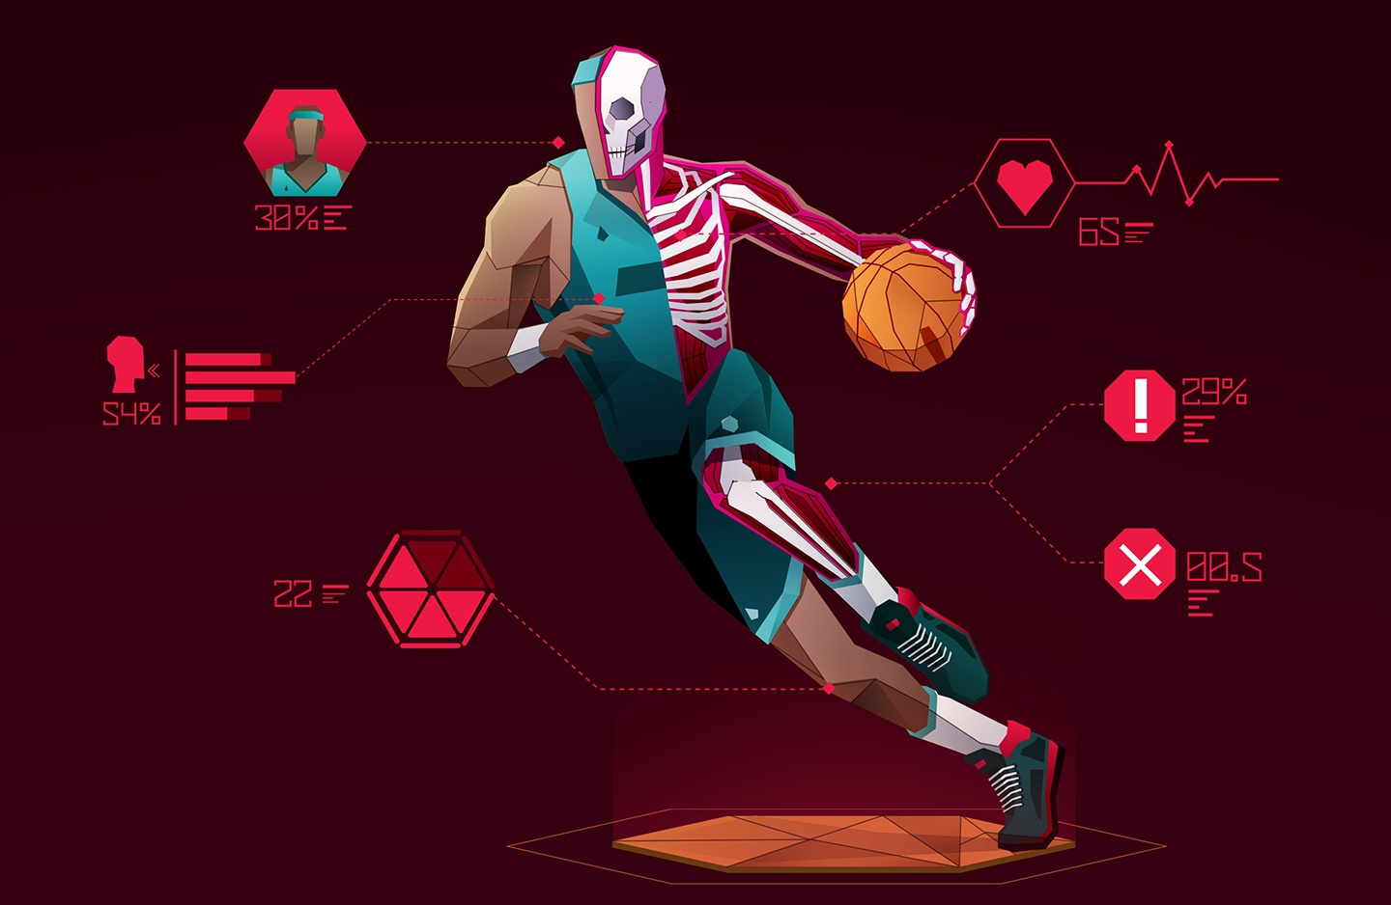
Introduction
Introduction: Sports analytics leverages data to gain insights into player performance, team strategies, and game outcomes. Player performance prediction is a critical area, enabling teams to optimize training, recruitment, and in-game decisions.
Literature Survey: Recent studies have shown that machine learning models, such as random forests and neural networks, outperform traditional statistical methods in predicting player performance (Smith et al., 2020). Bayesian approaches have also been effective in handling uncertainty in player data (Jones et al., 2019).

Slide 4

Basic Idea
Key Concepts: Probability distributions (e.g., normal, Poisson) and statistical methods (e.g., regression, hypothesis testing) form the foundation of player performance prediction.
Basic Idea: We use regression analysis and machine learning models to predict player performance based on historical data. Features such as points scored, assists, and rebounds are analyzed to forecast future outcomes."

Slide 5



Dataset: We use the NBA player stats dataset from Kaggle, containing metrics like points, assists, rebounds, and minutes played.
Preprocessing Steps:
Handle missing values.
Normalize/scale features.
Encode categorical variables (if any).
Data Collection & Preprocessing
Preprocessing ensures the data is clean and ready for analysis.

Slide 6

Feature Selection
Selected Features: We select key performance metrics such as points, assists, rebounds, and minutes played as input features.
Target Variable: The target variable is overall player performance, represented by a composite score or specific metric (e.g., points per game).

Slide 7


Model Training
Models Used: We implement Linear Regression and Random Forest Regression to predict player performance.
Implementation: Using Python libraries like scikit-learn, we split the data into training and testing sets, train the models, and evaluate their performance.

Slide 8

Results & Visualization
Results: Our Linear Regression model achieved an R-squared value of 0.85, indicating a strong correlation between features and player performance.
Visualization: We plot actual vs. predicted performance to visualize the model's accuracy.

Slide 9
Comparison & Conclusion
Comparison: Linear Regression outperforms traditional methods but falls short of advanced models like Random Forest, which achieved an R-squared value of 0.90.
Conclusion: Our study demonstrates the effectiveness of data-driven approaches in predicting player performance. Future work could explore deep learning models for improved accuracy.

Slide 10
References
Smith, J., et al. "Machine Learning in Sports Analytics: A Comprehensive Review." Journal of Sports Science and Technology, vol. 15, no. 3, pp. 45–60, 2020.
Jones, A., et al. "Bayesian Methods for Player Performance Prediction in Team Sports." International Journal of Data Science and Analytics, vol. 8, no. 2, pp. 123–135, 2019.
Kaggle. "NBA Player Stats Dataset." [Online]. Available: https://www.kaggle.com/datasets/drgilermo/nba-players-stats
Scikit-learn. "Machine Learning in Python." [Online]. Available: https://scikit-learn.org
Pandas. "Python Data Analysis Library." [Online]. Available: https://pandas.pydata.org
Matplotlib. "Python Visualization Library." [Online]. Available: https://matplotlib.org
TensorFlow. "Deep Learning Framework." [Online]. Available: https://www.tensorflow.org
James, G., et al. An Introduction to Statistical Learning: With Applications in Python. Springer, 2021.
Brownlee, J. "Machine Learning for Time Series Forecasting in Python." Machine Learning Mastery, 2020. [Online]. Available: https://machinelearningmastery.com
Miller, T., et al. "Sports Analytics: The Future of Performance Prediction." IEEE Transactions on Computational Intelligence and AI in Games, vol. 12, no. 4, pp. 345–357, 2021.

